Slide 1

بِسْمِ اللّٰهِ الرَّحْمٰنِ الرَّحِيْمِ

Slide 2
Android Layouts

Slide 3
Mobile Computing
Mobile Computing
LECTURE 05
Layouts
Instructor:
Maulana Haq Nawaz

Slide 4
تصحیح نیت
حضرت محمد صلی اللہ علیہ وسلم نے فرمایا
اِنَّمَا الْاَعْمَالُ بِالنِّـیَّاتِ
ترجمہ
اعمال کا دارومدار نیتوں پر ہے

Slide 5

دُعا

Slide 6
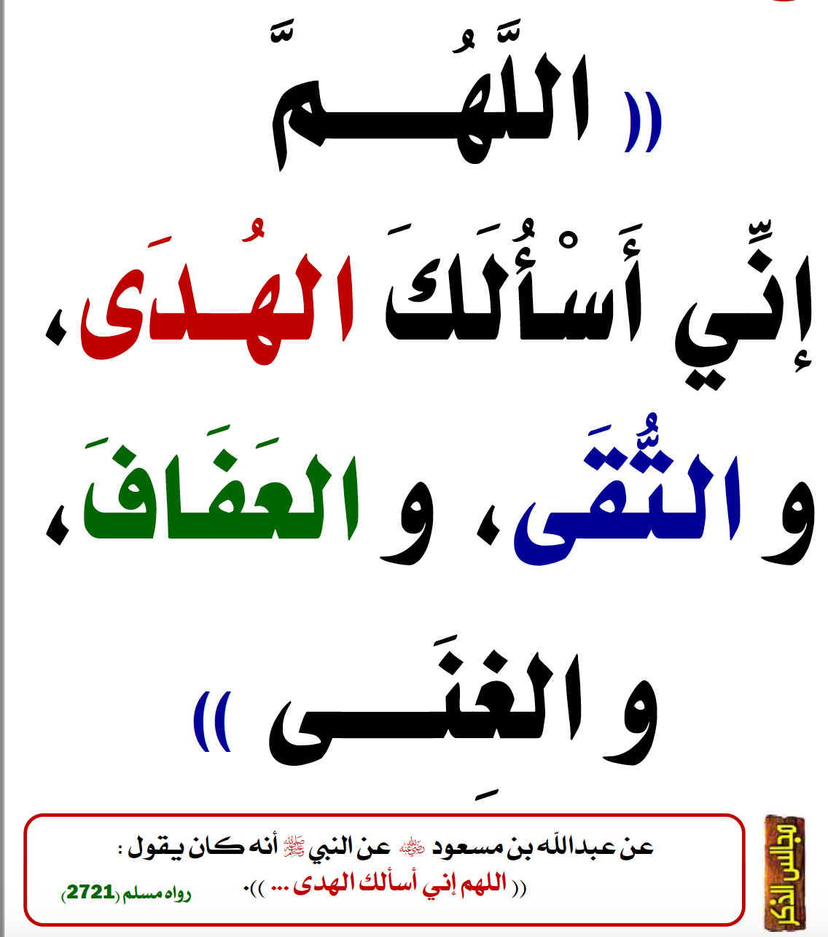
دُعا

Slide 7

Little Efforts Daily Will Make You the Greatest
To systematically learn and get excellence in any concept / subject
روز کا کام روز کریں
اک مہینے کا کھانا ایک دن میں نہیں کھایا جا سکتا، ایسے ہی ایک مہینے کا کام ایک دن میں نہیں ہو سکتا

Slide 8
Little Efforts Daily Will Make You the Greatest
Importance of completing tasks on daily basis
Main Reason of Failure in Life
یہ کام کل کریں گے
جو کام کبھی بھی ہو سکتا ہے وہ کبھی نہیں ہوتا
زندگی ایک دن ہے اور وہ ہے آج۔ زندگی میں کل نام کی کوئی چیز نہیں ہے
جو دن آپ کی زندگی سے چلا گیا اب واپس نہیں آئے گا
آج کا کام آج ہی ہوسکتا ہے
جو گز گیا وہ آنا نہیں ، آنے والے دن کا پتہ نہیں ، آج میدان جما ہے تو اپنے جوہر دکھاؤ

Slide 9
How to Achieve BIG Goals in Life
Balanced Life is Ideal Life 😊
To achieve BIG Goals in Life
Make a Schedule of 24 Hours with a focus on Five main components of Human Life
Health
Physical Health
Mental Health
Social Health
Spirituality
Work
Family
Friends

Slide 10



جو کام کریں دل سے کریں
کام کرنا.
خوشی خوشی کام کرنا.
الله کو ساتھ لے کرخوشی خوشی کام کرنا.
آیت: إِيَّاكَ نَعْبُدُ وإِيَّاكَ نَسْتَعِينُ
ترجمہ: یا الله ہم تیری ہی عبادت کرتے ہیں.
اور تجھ ہی سے مد د مانگتے ہیں

Slide 11
Lecture Outline
1
Revision
2
View ViewGroup
3
Layout
4
Layout Parameters
5
Constraint layout
6
Constraint Baseline
7
Constraint Centre
8
Chains
9
Constraint bias
10
Infer Constraints
11
Stop Complaining! Stop Criticizing! Let’s Start Contributing
12
Lecture Summary

Slide 12
View and ViewGroup
A View usually draws something the user can see and interact with.
A ViewGroup Invisible container

Slide 13
View and ViewGroup
The View objects are usually called "widgets" and can be one of many subclasses, such as Button or TextView.
The ViewGroup objects are usually called "layouts" can be one of many types that provide a different layout structure, such as LinearLayout or ConstraintLayout .

Slide 14
View and ViewGroup
Each layout file must contain exactly one root element, which must be a View or ViewGroup object. Once you've defined the root element, you can add additional layout objects or widgets as child elements to gradually build a View hierarchy that defines your layout. For example, here's an XML layout that uses a vertical LinearLayout to hold a TextView and a Button:

Slide 15
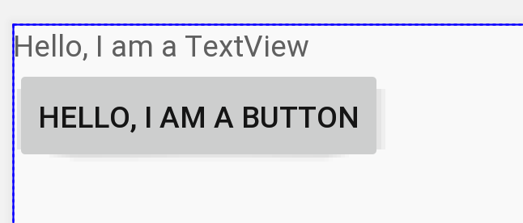
View and ViewGroup
<LinearLayout xmlns:android="http://schemas.android.com/apk/res/android" android:layout_width="match_parent" android:layout_height="match_parent" android:orientation="vertical" > <TextView android:id="@+id/text" android:layout_width="wrap_content" android:layout_height="wrap_content" android:text="Hello, I am a TextView" /> <Button android:id="@+id/button" android:layout_width="wrap_content" android:layout_height="wrap_content" android:text="Hello, I am a Button" /> </LinearLayout>

Slide 16
Load XML Resources
package org.haqnawaz.layout; import androidx.appcompat.app.AppCompatActivity; import android.os.Bundle; public class MainActivity extends AppCompatActivity { @Override protected void onCreate(Bundle savedInstanceState) { super.onCreate(savedInstanceState); setContentView(R.layout.activity_main); } }

Slide 17
Layout Parameters
XML layout attributes named layout_something define layout parameters for the View that are appropriate for the ViewGroup in which it resides.
Every ViewGroup class implements a nested class that extends ViewGroup.LayoutParams. This subclass contains property types that define the size and position for each child view, as appropriate for the view group

Slide 18
Constraint Layout
To define a view's position in ConstraintLayout, you must add at least one horizontal and one vertical constraint for the view.
Each constraint represents a connection or alignment to another view, the parent layout, or an invisible guideline.
Each constraint defines the view's position along either the vertical or horizontal axis; so each view must have a minimum of one constraint for each axis, but often more are necessary.
If a view has no constraints when you run your layout on a device, it is drawn at position [0,0]

Slide 19
Guess

Slide 20
Answer

Slide 21
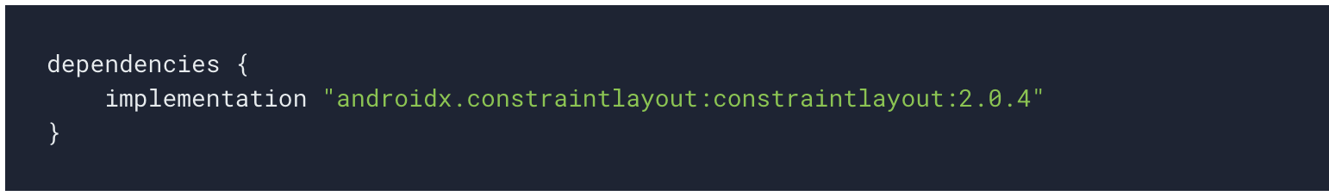
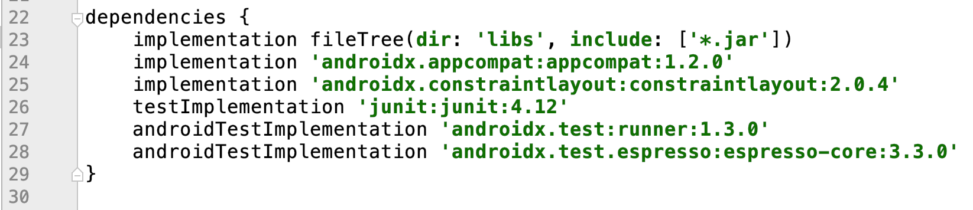
Required Dependency

Slide 22
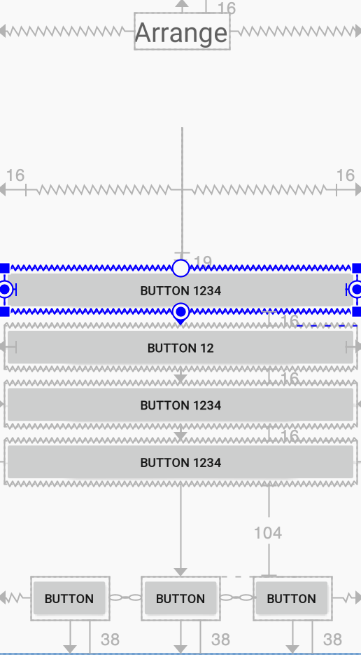
Constraint layout

Slide 23
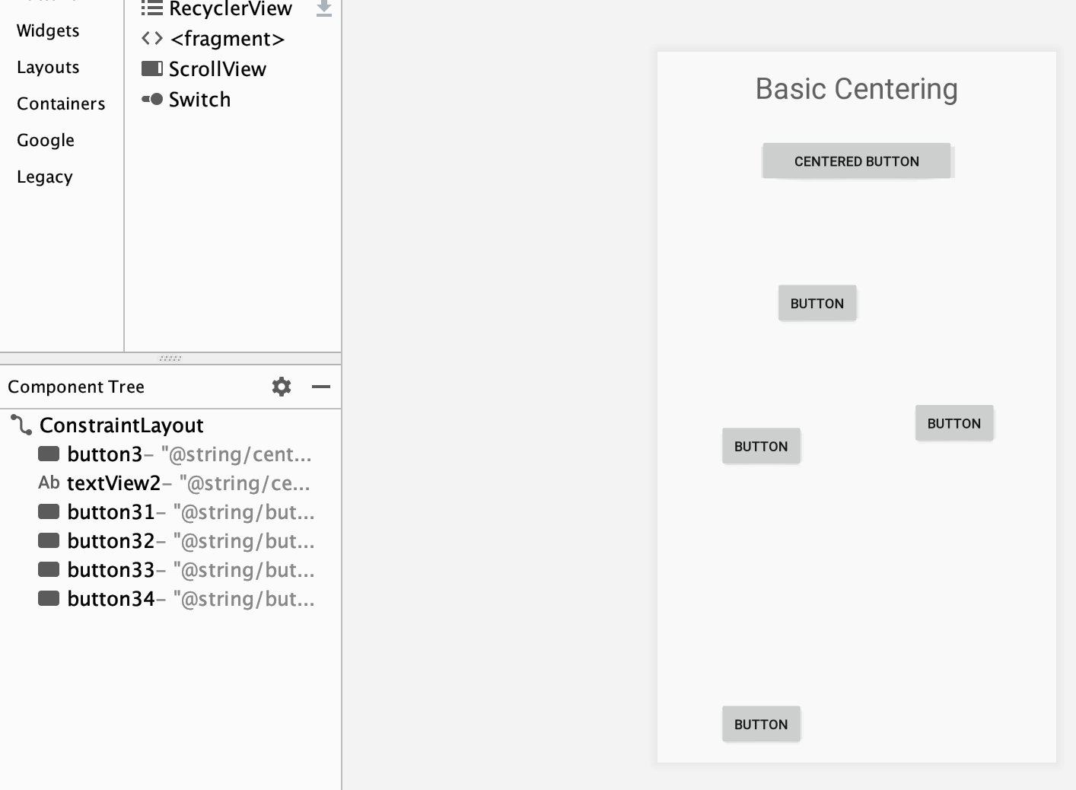
Constraint layout

Slide 24
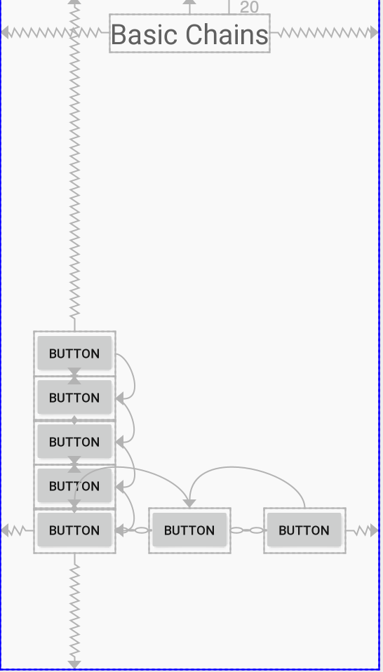
Constraint layout

Slide 25
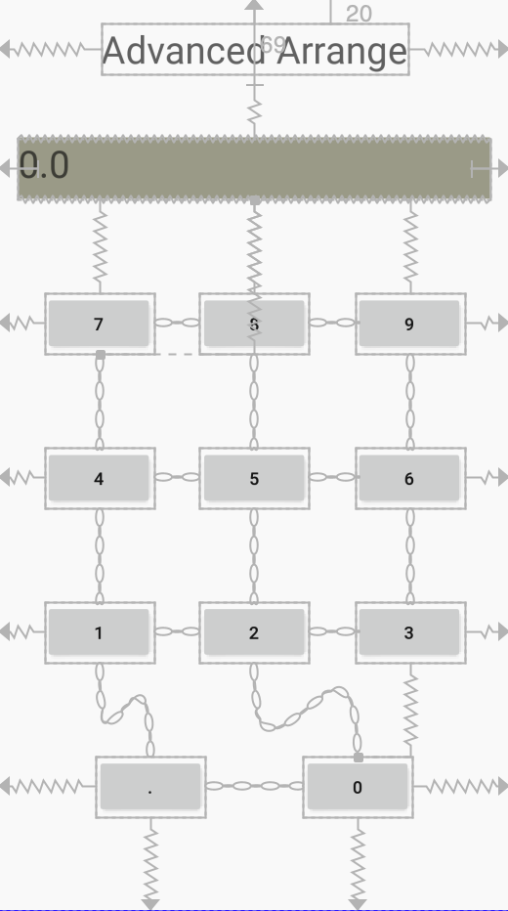
Constraint layout

Slide 26
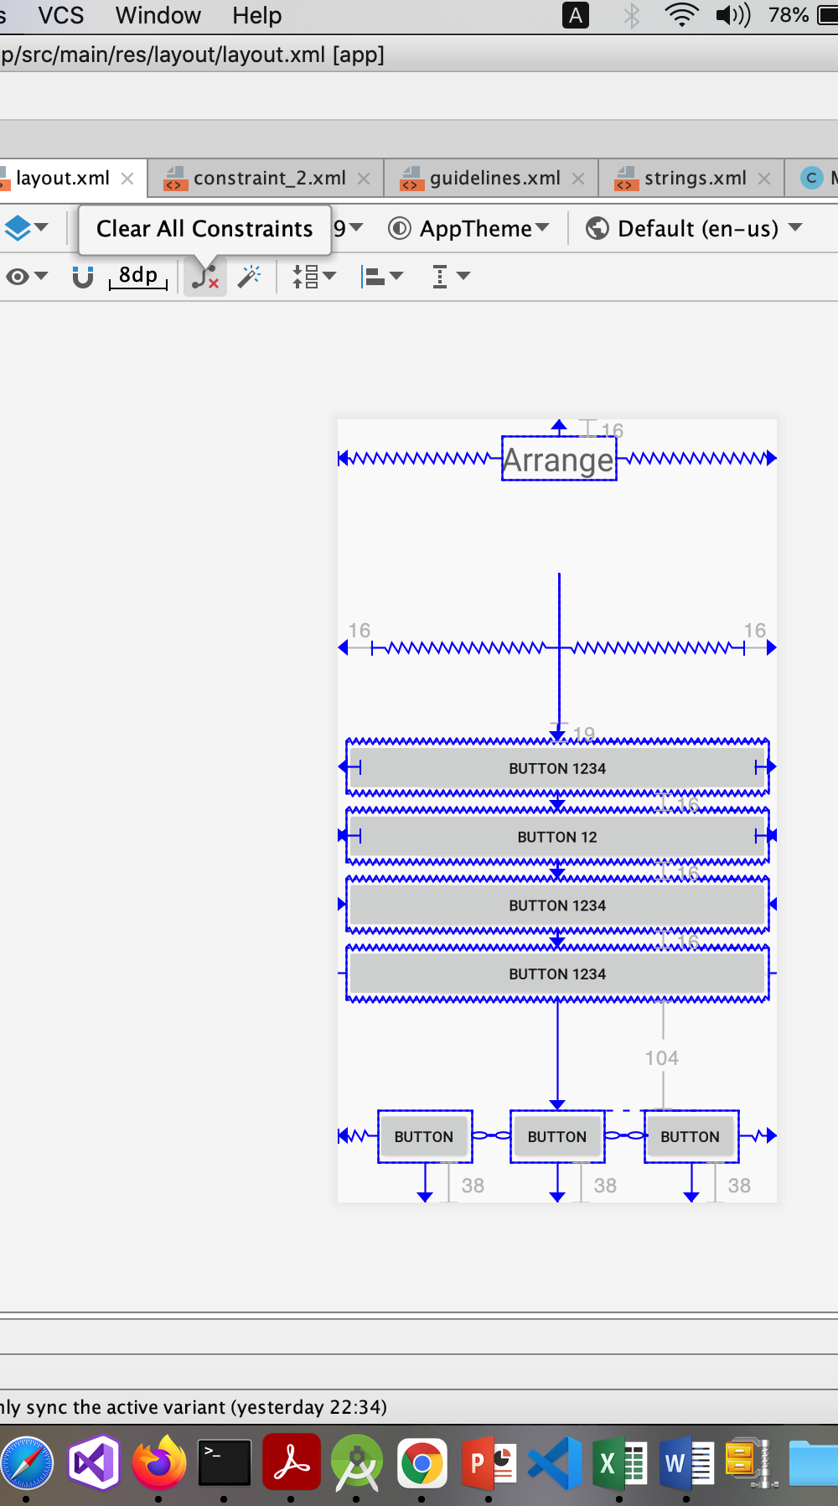
Clear all constraints

Slide 27
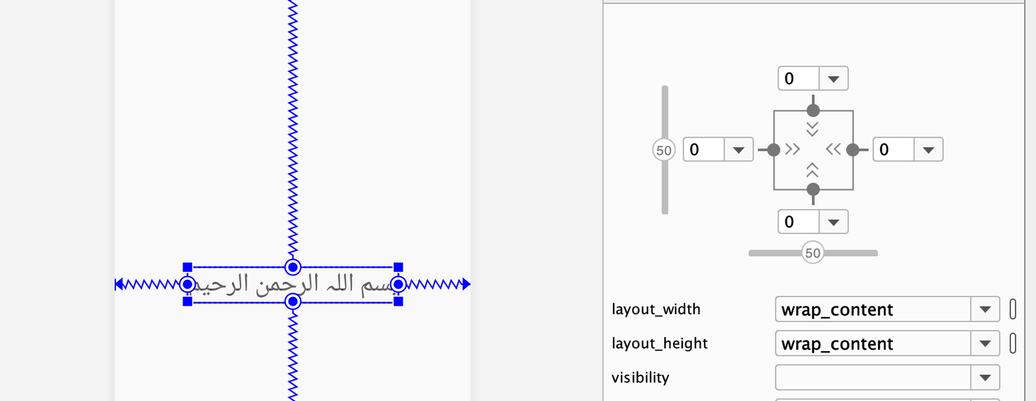
Layout Constraint

Slide 28
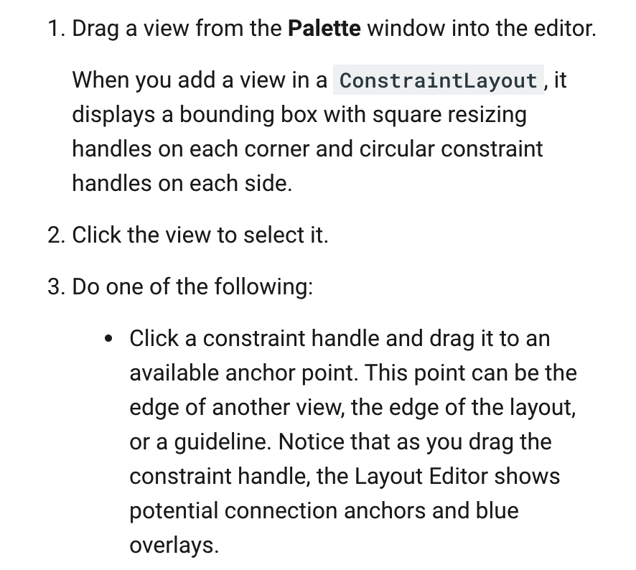
Add or Remove Constraint

Slide 29
Constraint Layout

Slide 30
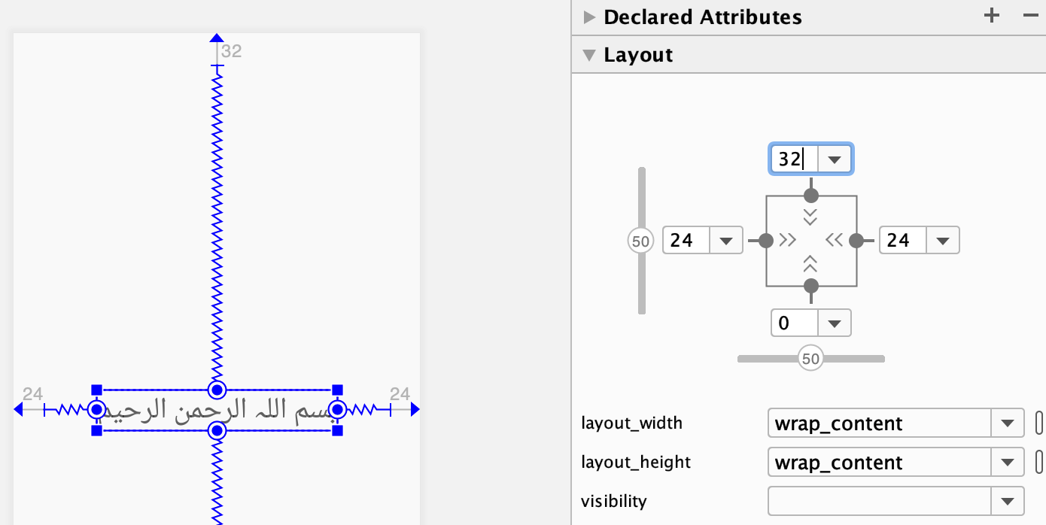
Layout Constraint

Slide 31
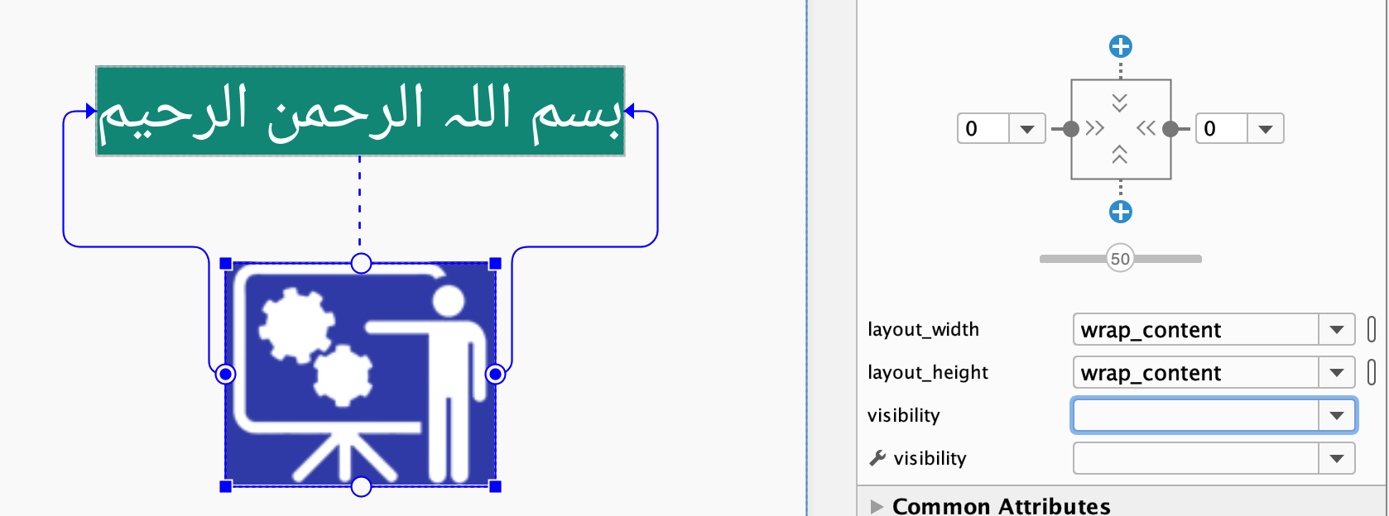
Layout Constraint

Slide 32
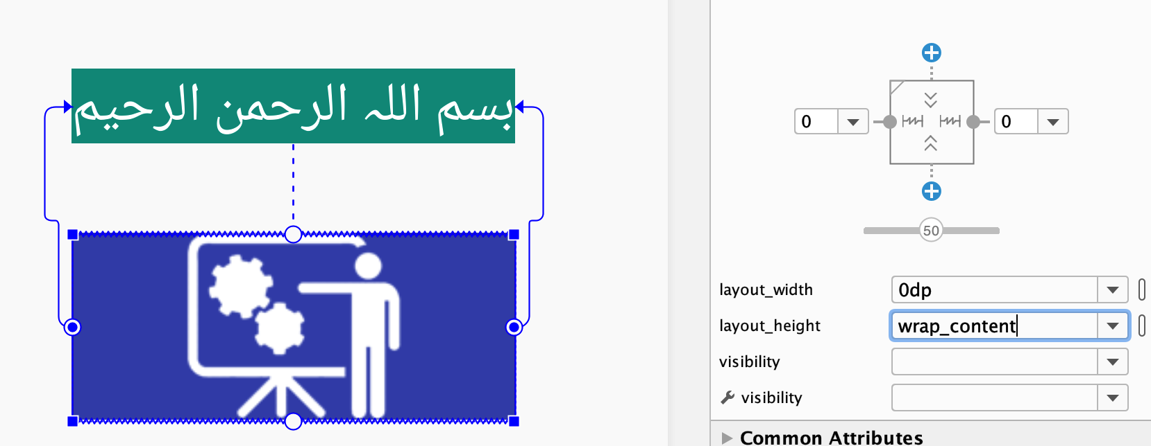
Layout Constraint

Slide 33
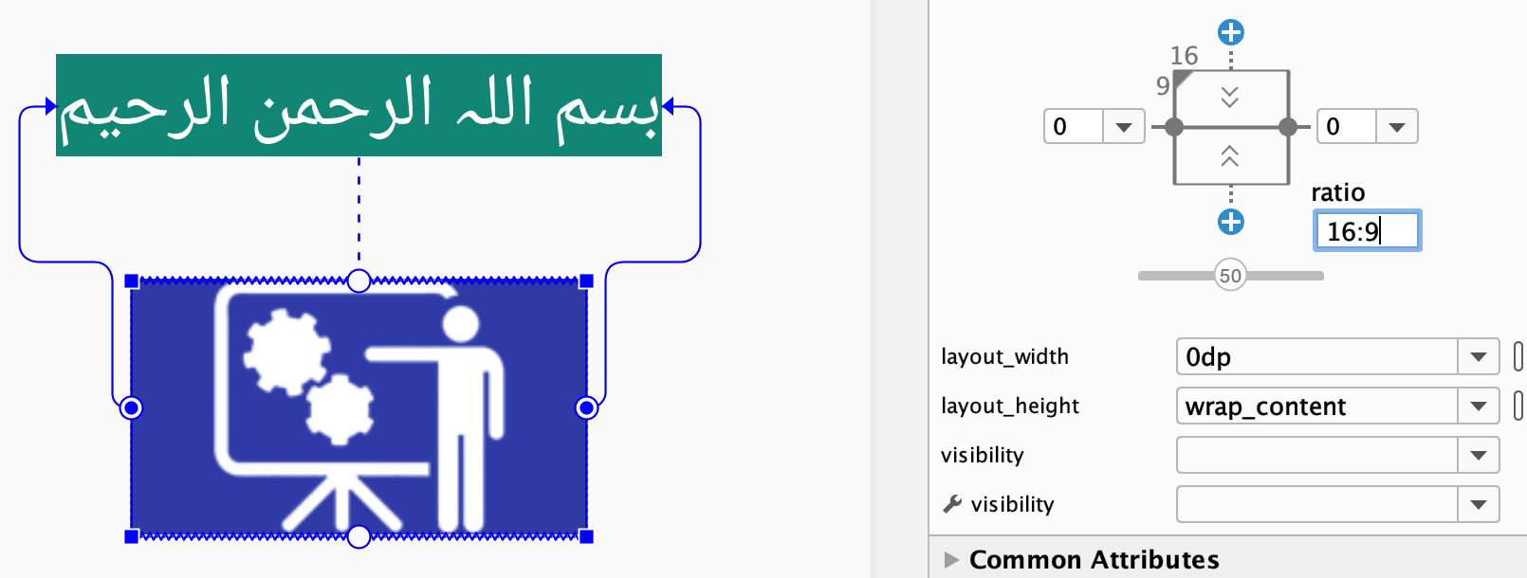
Layout Constraint 16:9

Slide 34
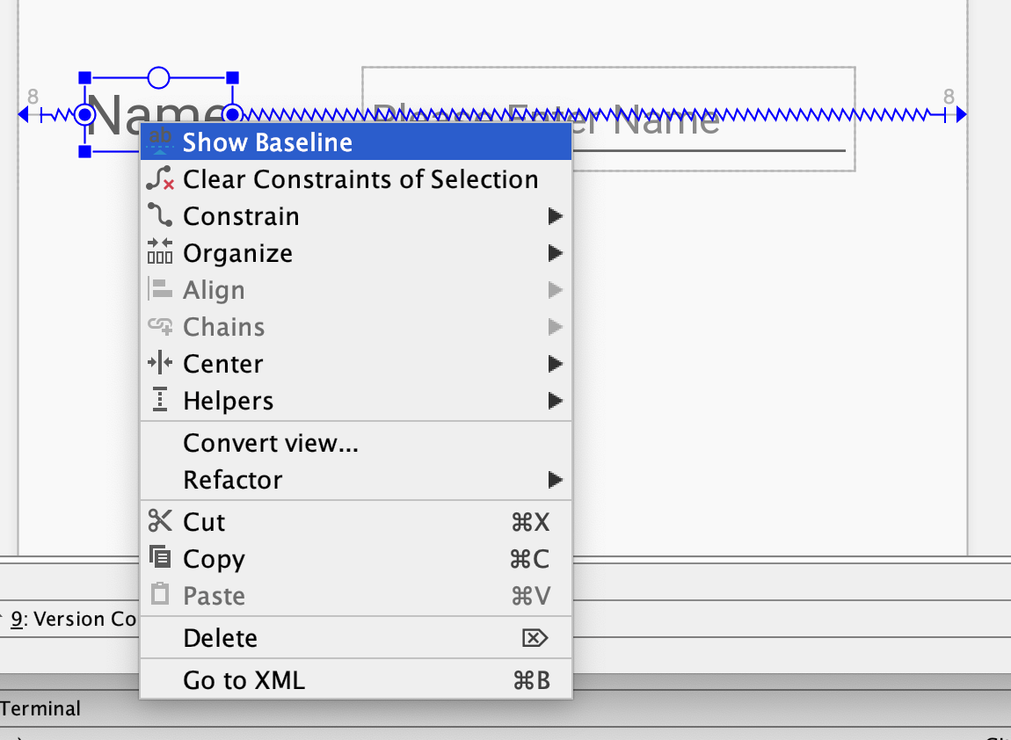
Layout Constraint Baseline

Slide 35
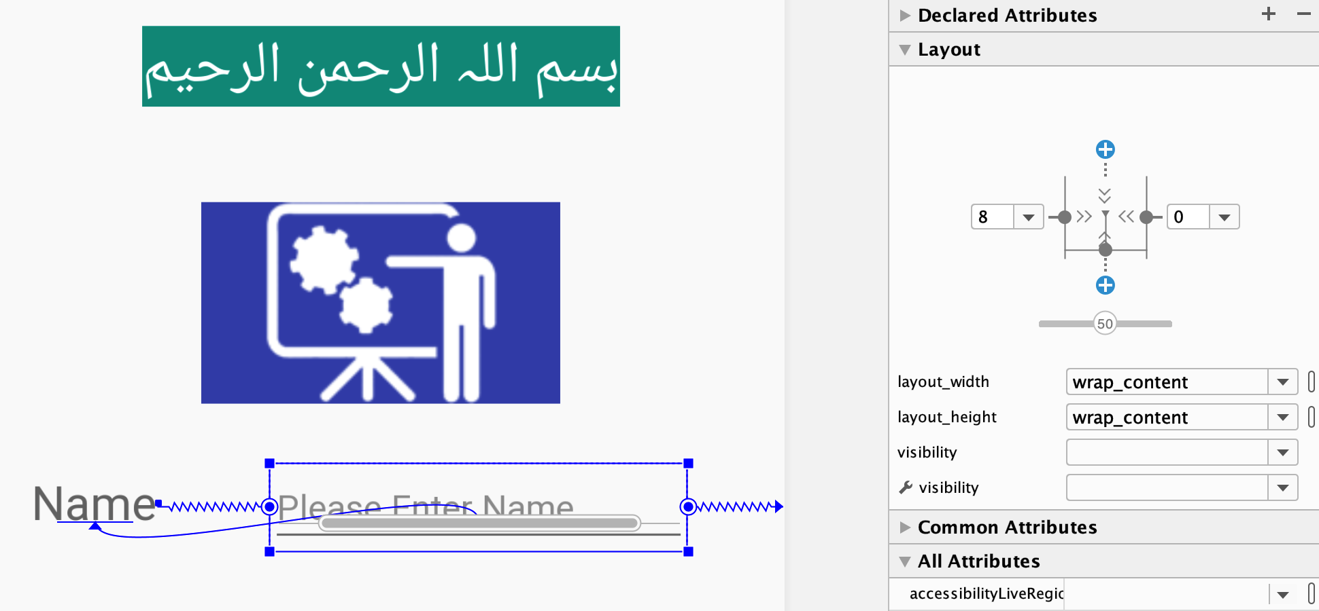
Layout Constraint Baseline

Slide 36
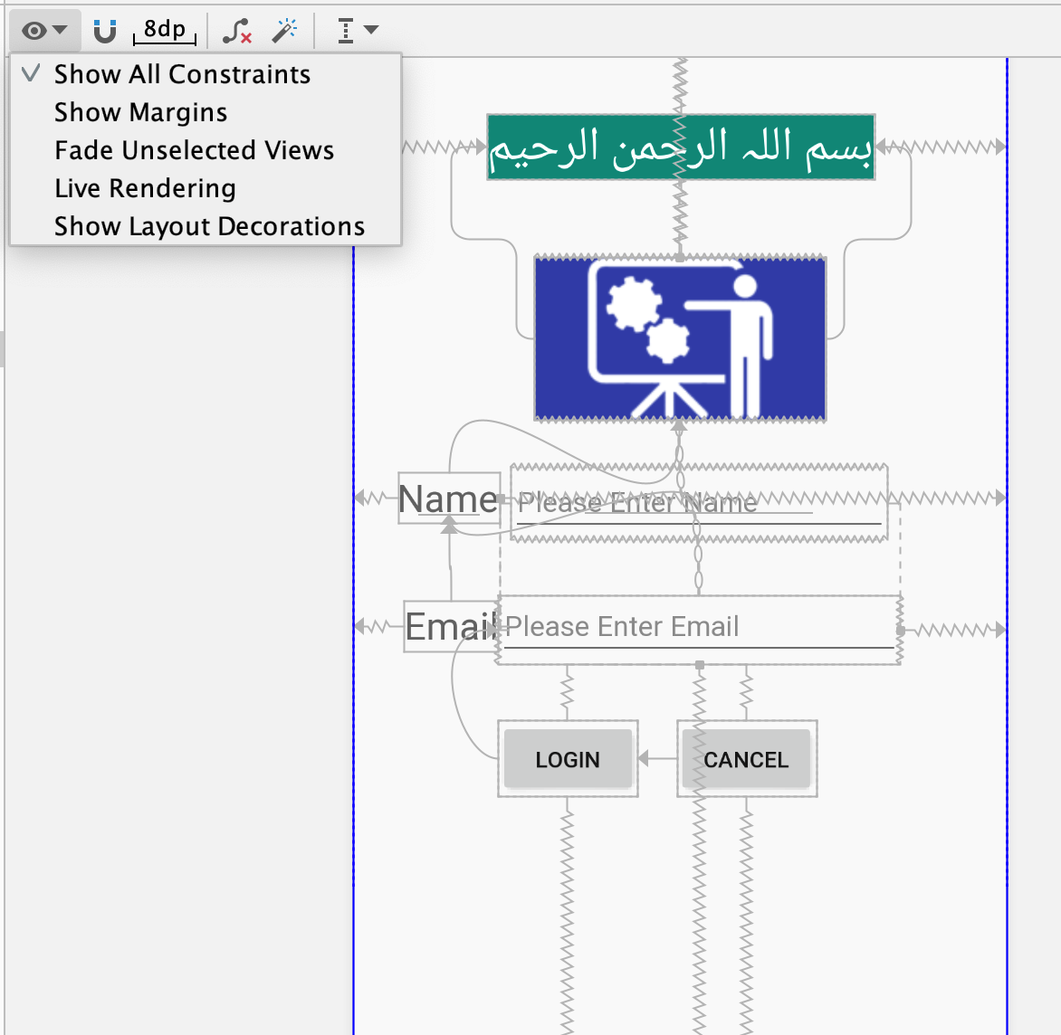
Layout Constraint Baseline

Slide 37
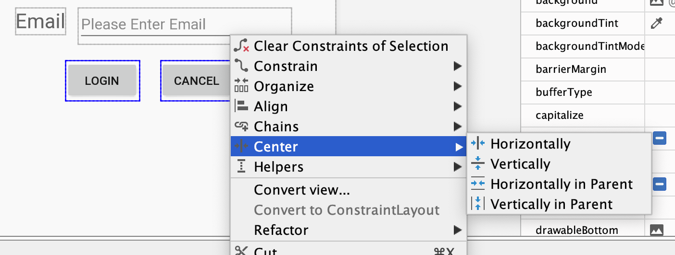
Layout Constraint Centre

Slide 38
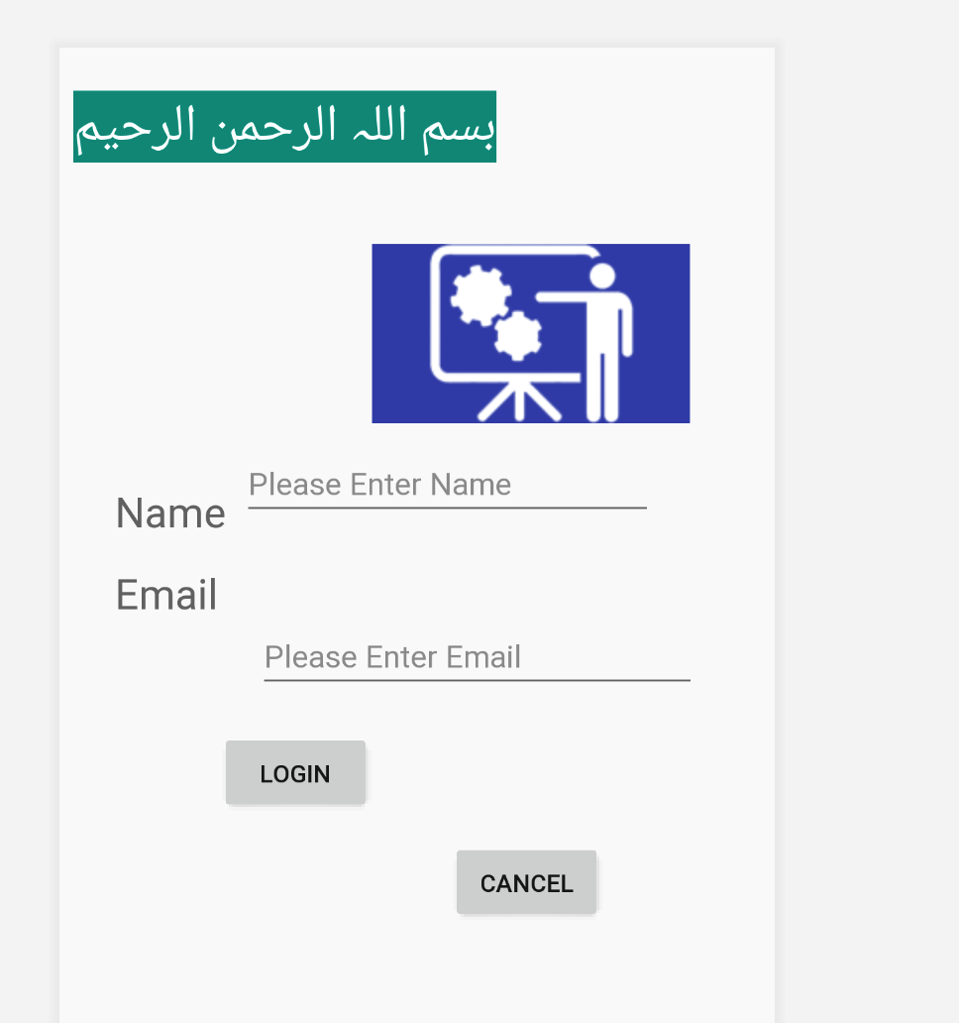
Layout Constraint

Slide 39
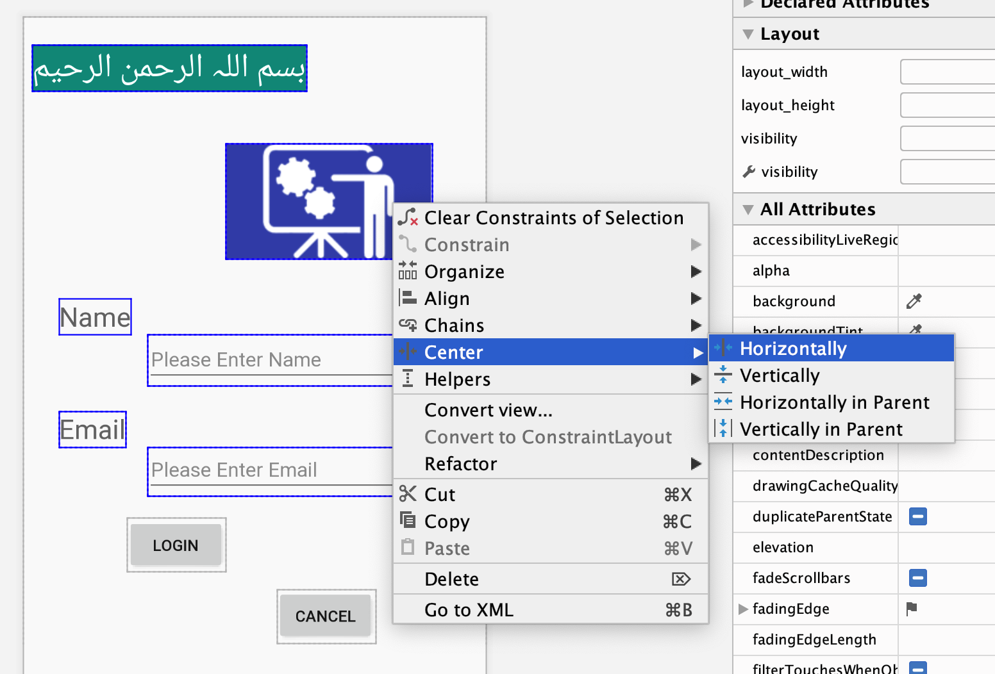
Layout Constraint Center

Slide 40
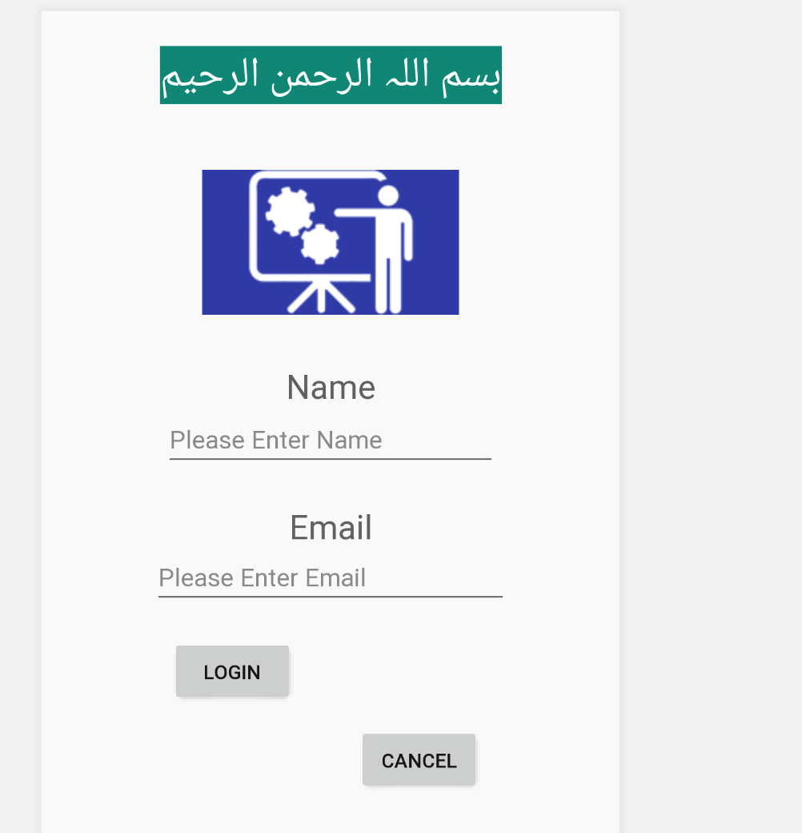
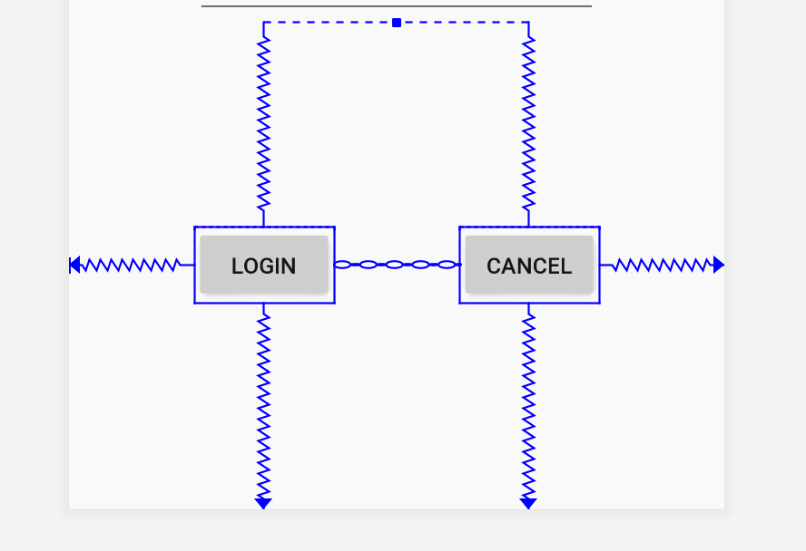
Layout Constraint Center

Slide 41
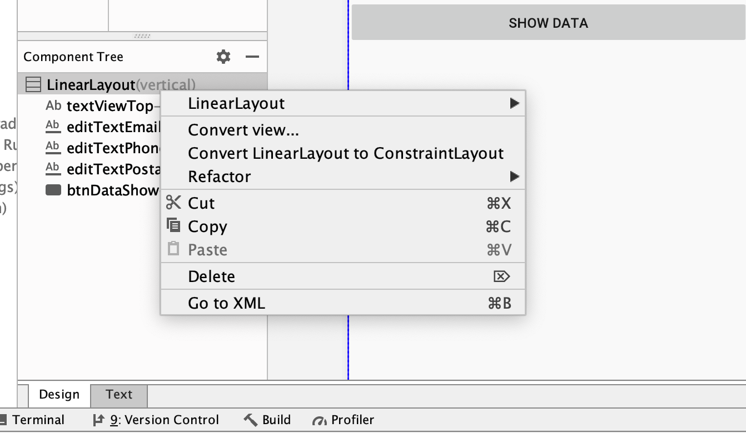
Layout Conversion

Slide 42
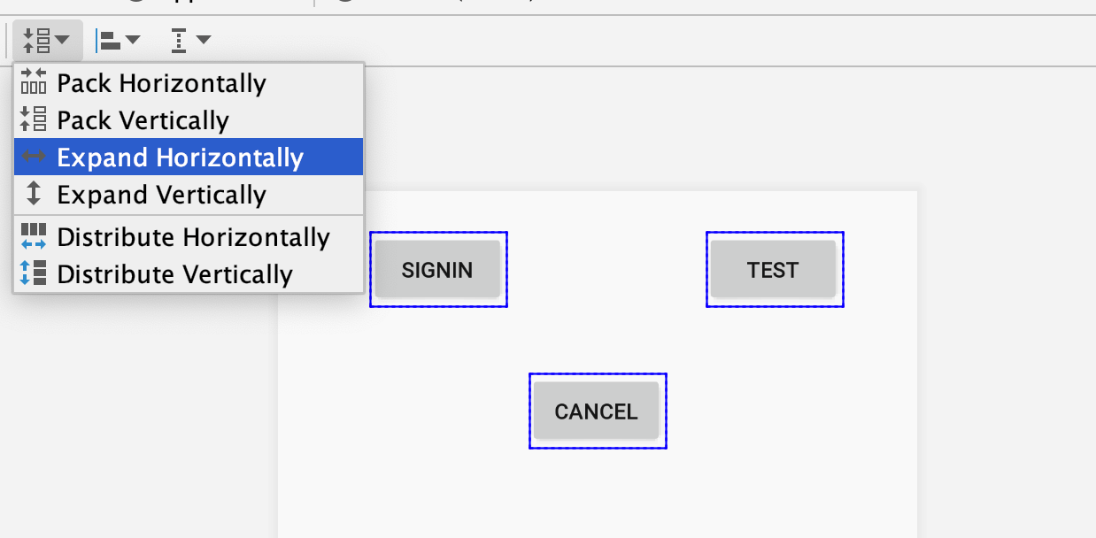
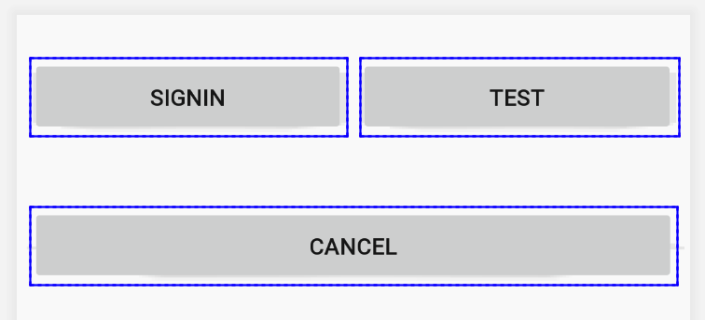
Layout constraint Expand Horizontally

Slide 43
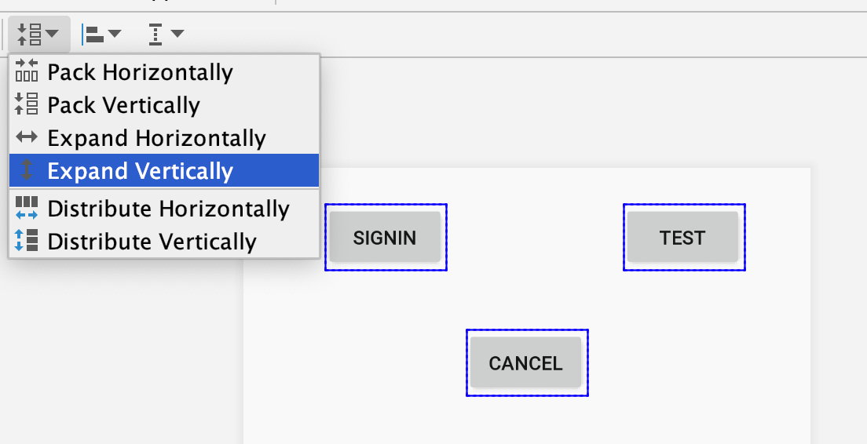
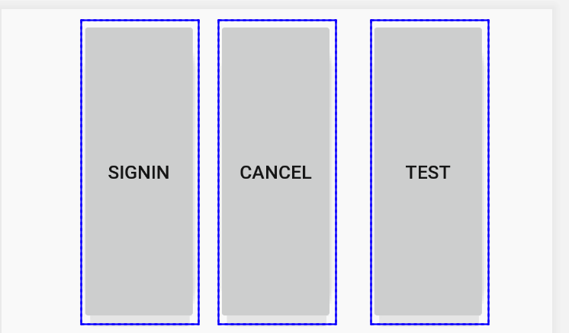
Layout constraint Expand Vertically

Slide 44
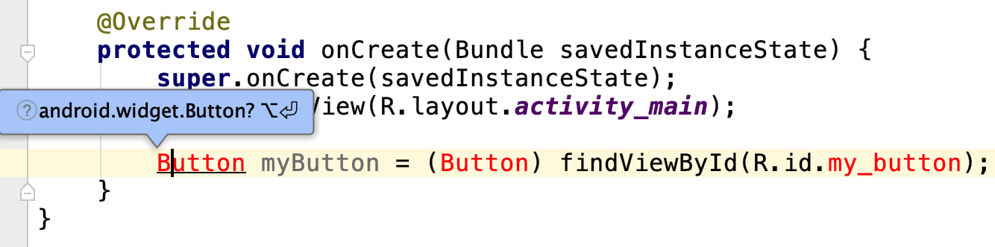
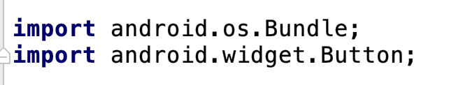
Load XML Resources

Slide 45
Resources
https://developer.android.com

